Slide 1

Problem Solving Session
The remainder of today’s class will comprise the problem solving session (PSS).
Your instructor will divide you into teams of 3 or 4 students.
Each team will work together to solve the following problems for the time remaining in today's class.
You may work on paper, a white board, or digitally as determined by your instructor.
You will submit your solution by pushing it to GitHub before the end of class.
Your instructor will go over the solution before the end of class.
If there is any time remaining, you will begin work on your homework assignment.
Class participation is a significant part of your grade (20%). This includes in class activities and the problem solving session.
Your graders will grade your participation by verifying that you pushed your solutions before the end of the class period each day.

Slide 2
Problem 1
Name: Jackson Palmer | Major: Web & Mobile
Place of origin: Rochester NY
One interesting fact about me: I know every country flag
Name: Elly Medcalf | Major: Computing, Humanities, and Design (previously DHSS)
Place of origin: West Carrollton, OH
One interesting fact about me: I have a magnet collection
Name: Bryan Navarro | Major: Digital Humanities and social sciences
Place of origin: Rochester, NY
One interesting fact about me: I made a website once. It wasn’t very good
Getting to know your classmates helps to form a community of students and faculty with a shared goal: helping everyone to succeed in this course.
Creating a network of friends and colleagues will give you a base of support if you need help on your assignments or developing a better understanding of the material.
Providing help and explaining concepts to your peers is also a great way to get a more solid grasp on material. It's a win-win!
Spend some time getting to know your team. Fill out the table to the left with information about each member of your problem solving team.
If you are working digitally and need more space, duplicate this slide.

Slide 3
Problem 1
Name:Hiroto Takeuchi (Hiro) | Major: Software Engineer
Place of origin: Japan
One interesting fact about me: I have ran a full marathon
Name: Evan Ke | Major: Web and Mobile
Place of origin: Bronx, NY
One interesting fact about me: I am able to play most sports
Name: Ryan Robison | Major: Mece trying to switch into Software Engineering
Place of origin: Ashburn , VA
One interesting fact about me: I have 4 siblings
Getting to know your classmates helps to form a community of students and faculty with a shared goal: helping everyone to succeed in this course.
Creating a network of friends and colleagues will give you a base of support if you need help on your assignments or developing a better understanding of the material.
Providing help and explaining concepts to your peers is also a great way to get a more solid grasp on material. It's a win-win!
Spend some time getting to know your team. Fill out the table to the left with information about each member of your problem solving team.
If you are working digitally and need more space, duplicate this slide.

Slide 4
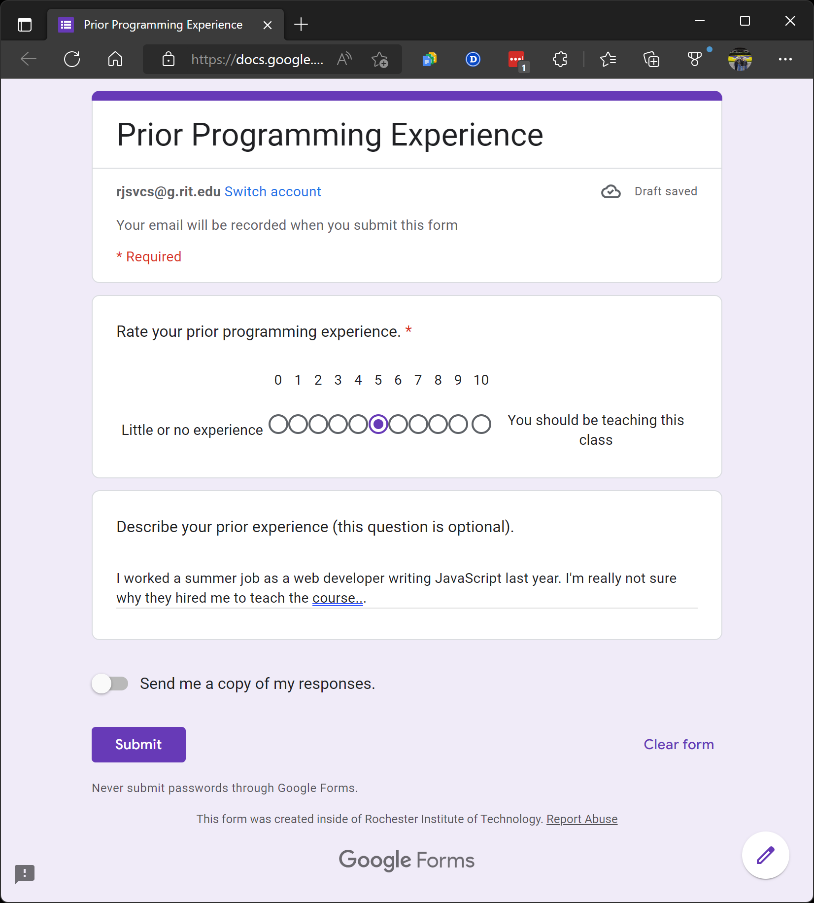
Problem 2
Software Development & Problem Solving is designed for students of all levels of experience. There are students in this classroom with little or no programming experience, students who have been coding for years, and every skill level in between.
Spend a few minutes talking with your team members about your prior experience with programming (in any language, not just Python).
Rate yourselves on a scale of 0 (very little or no experience) to 10 (you should be teaching this class!).
Use this Google form to tell us about your prior experience. The results will be shared anonymously on the course Discord server.
You will be required to log into your RIT Google account to access the form.

Slide 5

Problem 3
D
C
Files in the file system are organized into a tree structure. Visualizing this structure can make finding files and directories more intuitive.
Assume that each of the following is an absolute path to a file in your file system. Draw the tree that represents the structure in the space on the left.
Your instructor will determine if you should work digitally, on paper, or on a whiteboard. Use the icons to the left as references.
Program Files
Games
stuff.txt
Users
WoW
Ron
Harry
wow.exe
todo_list.txt
Git
/c/Users/Ron/Documents/biography.txt
/c/Users/Ron/SoftDevI/Week01/homework.txt
/c/Users/Harry/todo_list.txt
/c/Program Files/Python/python.exe
/c/Program Files/Git/git.exe
/d/Games/WoW/wow.exe
/d/stuff.txt
Documents
SoftDev1
git.exe
Python
biography.txt
Week01
homework.txt
python.exe

Slide 6
Problem 4
Vi new_file.txt Creates a new text file and opens up the Vi editor
2. Vi new_file.txt (add text) Allows you to edit the file and add text directly to the file
3. git add new_file.txt Adds the new_file.txt to the git staging area where it is ready to be commited
4. git commit -m “adding a new file” Telling the remote repository the logic behind sending the file.
5. git push Sends file from local repository to the remote repository
Understanding the status of the files in your repository is important! Have you made changes to any files that need to be committed? What has been added, modified, deleted, or staged since your last commit?
Consider the following commands executed in a Git repository on your computer. Together with your team, describe the status of the file at each step.
vi new_file.txt
git add new_file.txt
git commit -m "adding a new file"
git push
vi new_file.txt (add text)

Slide 7
Problem 5
It is a good idea to check because you want to make sure that you are working with the correct files
2. Read instructions thoroughly to gain a clear understanding of the assignment so you know what you should be completing and how.
3. You should push everything you have just done to the remote repository.
4. Clone the git repository.
Proper use of version control means understanding why we use it and not just memorizing how to use it.
Discuss the following questions with your team, and type or write your answers in the space on the right.
Why do you think that it is a good idea to check the status before staging files?
When starting a brand new assignment, what is the first thing you should do, and why?
What is the last thing that you should do before taking a break from working?
Assume that you are getting back to work on a different computer. What is the first thing you should do?

Slide 8
Problem 6
Spelling/capitalization mistakes. To overcome it just checked spelling and capitalization as well as make sure the commands we used didn’t have anything mistyped like an extra space or missing a letter or dash
Using Git Bash commands in the Windows Command Line. del/rm for example I mixed u not knowing that these two lines use different commands
Trying to figure out how to use terminal commands on the Mac when the entire class is centered around Windows. I went to office hours and asked a classmate for help.
Making and overcoming mistakes is an essential part of problem solving.
Talk with your team and identify at least three mistakes that you made and overcame throughout any of the class activities or homework assignments in this unit. Did any of you make the same kind of mistake?
Be sure to describe specifically what you did to overcome each mistake. Did you look up the solution in the slides? Ask for help on the Discord server? Go to office hours? Something else?

Slide 9
Problem 7
The hash of the file. It is a 32 bit line that differentiates the file from different ones so that you can know which file to restore to.
The author’s name and email. This is useful when working with a team so that you can be aware of who made certain changes and how to contact them if you run into any issues.
The time and date that the version was created. Helpful for when you hit a snag in your program and you know that it was correct yesterday but something is wrong today. You can use this information to know which hash you need to restore.
The comment entered with the commit. This is helpful when you want to know exactly what you did in a specific edit.
Each entry in a Git log contains 4 pieces of information.
Describe each piece of information and under which circumstances it might be useful.
Consider how the usefulness of the log would be affected by the the frequency of commits and the quality of the comments that you use when you commit to the repository.

Slide 10
Problem 8
You continue a work in progress on a new computer. Hopefully you committed and pushed the file you were working on before to github, that way, when you continue a work in progress on a new computer, you can clone the github repository and continue working from there
You accidentally delete the file “important.txt”. You can do git restore
You want to reuse a file from a previous assignment. You can make a copy
You want to throw away recent changes that you made to a file. You can use the git checkout to go back to a previous version of the file.
You forgot to push your solution before the assignment deadline.
Together with your team, brainstorm a solution for each of the situations/problems listed to the left.
If you finish early, you should use the remaining class time to begin working on your homework.

